Slide 1
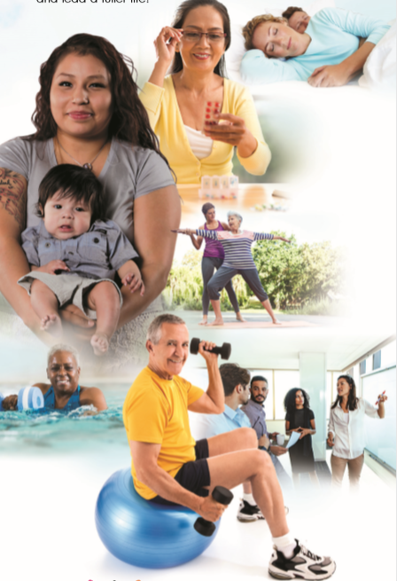
WORKSITE CHRONIC DISEASE SELF-MANAGEMENT WORKSHOP
[Day of the Week] [Month] [Dates] [Year] [Times]
[Location]
Workshops are
FREE!
To register, call 1-888-484-3800 or go to www.BetterChoicesBetterHealthSD.org
Why Should I Attend?
Those who have taken the workshop have:
Better health
More energy and less fatigue
Improved work performance
Increased confidence & support
Workshop Topics: (2x weekly / 1-hour sessions / 6 weeks)
Balancing work / home life
Time management
Dealing with stress, pain, frustration, & fatigue
Tips to improve strength, flexibility, & endurance
Goal setting & problem solving
Managing difficult emotions, isolation, ad poor sleep
Workshops are offered by the employer to employees who are interested in learning ways to achieve balance when managing chronic conditions and finding physical and mental health wellness in the workplace.
Put logo here
PROUDLY SUPPORTS BETTER CHOICES, BETTER HEALTH® SD
Better Choices, Better Health® SD adheres to AA/EEO guidelines in offering educational programs and services. Better Choices, Better Health® SD is used with permission as a licensed and trademarked program from SMRC.

