Slide 3
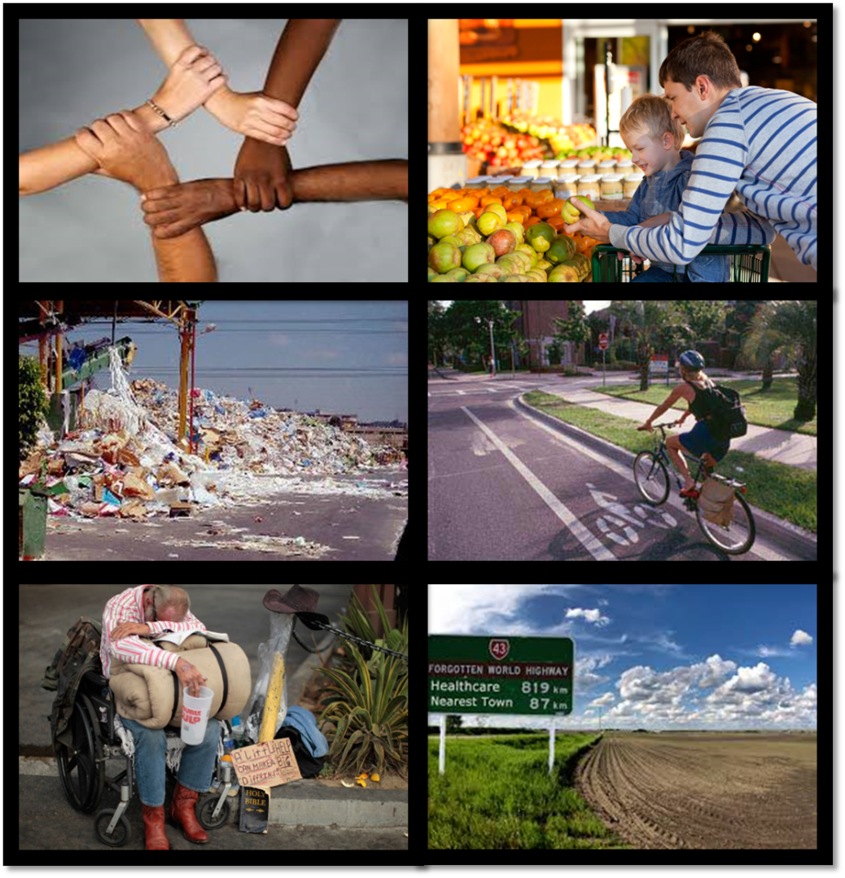
Social Determinants of Health

Slide 4
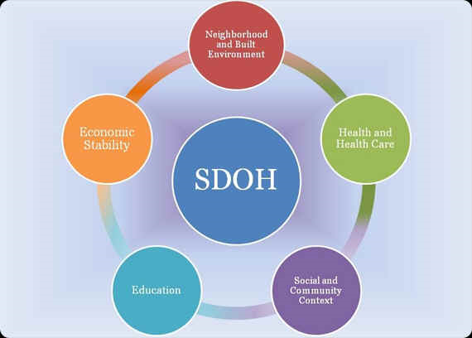
National Healthy People 2020 Social Determinants of Health Goal
Notes:
Create social & physical environments that promote good health for all
This emphasis is also shared with the WHO, as well as other US Health Initiatives such as the National Partnership for Action to End Health Disparities, and the National Prevention and Health Promotion Strategy.
5 key areas developed by Healthy People 2020
Economic Stability: poverty, employment, food security, housing stability
Education: High School Graduation, Enrollment in higher education, Language and literacy, early childhood education and development
Social & Community Context: Social cohesion, civic participation, perceptions of discrimination and equity, incarceration
Health & health care: access to health care, access to primary care, health literacy
Neighborhood & Built Environment: Access to healthy foods, quality of housing, crime and violence, environmental conditions

Slide 5
Notes:
What we know: People with more education are likely to live longer, experience better health outcomes, and practice more health promoting behaviors such as exercising regularly, refraining from smoking, and obtaining timely and healthy care check ups and screenings
Ways education shapes health behaviors: greater health knowledge. Education is linked to options of employment and income . Having more education and a better job is also linked with social support, networks, and norms that support healthy behaviors and discourage behaviors that are health harming. Adults educational attainment is also linked with their child’s health beginning early in life
Within this map the range goes from 23.2% in Bennet to 4.4% in Lincoln

Slide 6
Notes:
Those living in poverty are more likely to suffer from chronic health problems. Including depression, asthma, and obesity . A study also showed diabetes, high BP and heart attacks were slightly higher. We also know smoking is more prevalent among those living in poverty .
As you can see there are counties within our state with high levels of poverty.
Union and Lincoln have the lowest poverty rates while Oglala Lakota has the highest

Slide 7
Notes:
As in the previous slide and this slide the issue is economic resources. The greater resource the more likely people are to make health promoting choices such as healthy food, access to more physical activity options.

Slide 8
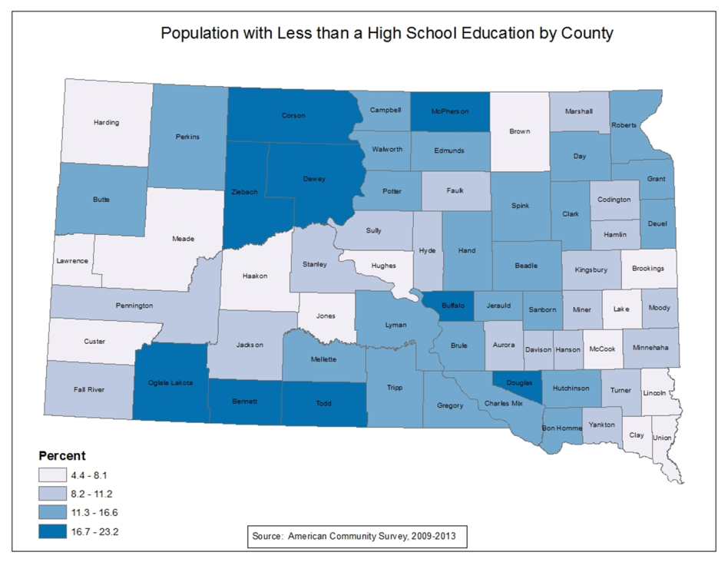
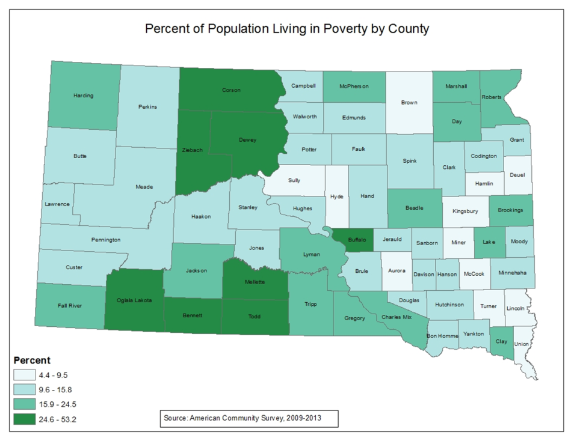
Notes:
So lets take a look at some specific indicators and the relationship between income and education

Slide 9
Fair or Poor Health Status
Notes:
(BRFSS 2013_2014)

Slide 10
Notes:
This data is from County Health Rankings which combines years of data from BRFSS. The top 5 reporting the lowest percent of fair/poor health status was Clay-5%, Hand-6%, Sully, McPherson and Miner at 7%
Those with the higher prevalence was Dewey at 23%, Buffalo-21, Corson-21, Todd, Douglas, and Oglala Lakota at 20%

Slide 11
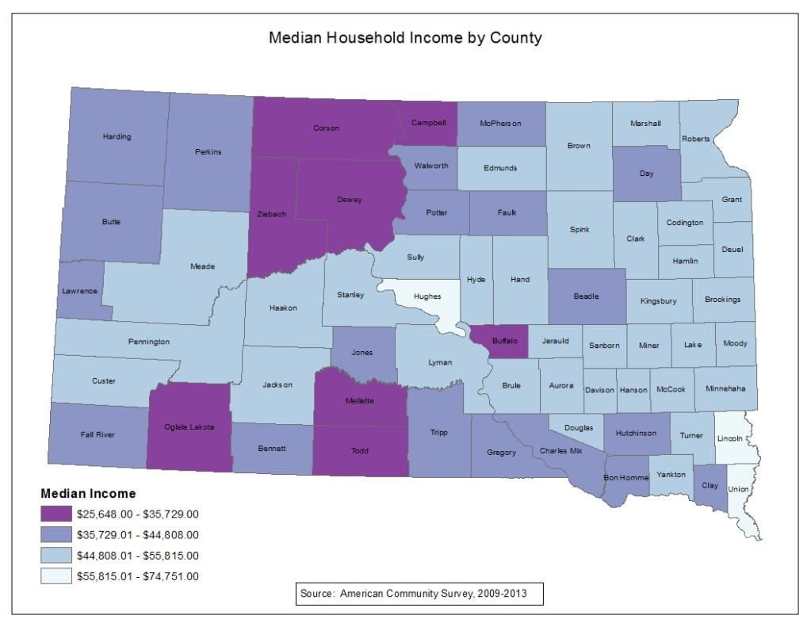

Slide 12
Prevalence of 2 or more Chronic Conditions
Notes:
Another element that affects a persons overall health status is the prevalence of more than one Chronic Condition . And treating MCC is also more costly and complicated. Within SD the combined rate of 2 years of date is 36.5. So slightly more than one out of 3 people have MCC. As you can see again those with lower income are more likely to be affects as well as those with lowest education.
(BRFSS )

Slide 13
Diabetes Prevalence
Notes:
2 years combined data results in a prevalence of 9.1 with difference with statistical difference in education . Those in the lower income group have a rate 2xs as high as those in the highest income group.
(2013_2014)

Slide 14
Notes:
Within diabetes the counties with the lowest prevalence include :Edmunds & Lawrence -6.6%, Butte-6.9% and Brookings, Lincoln and Yankton -7.0%
Counties with the highest rate-Oglala Lakota-19.4%, Todd, 18.6, Buffalo-18.4, Ziebach-16.0 and Dewey at 15.1

Slide 15
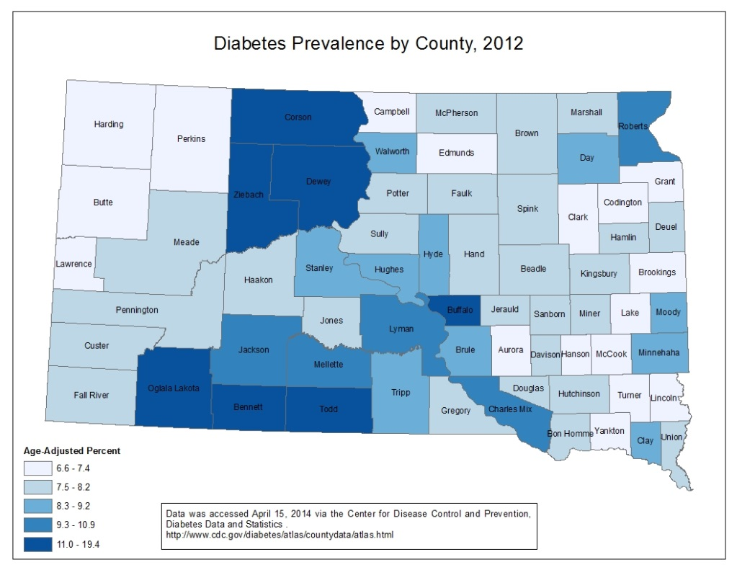

Slide 16
Healthy Eating
Notes:
As you can see people in lower income households tend to eat less vegetable; within our data the pattern isn’t as evident in relation to fruits. While it can’t be drawn from this graph it has been shown that the quality of residents diets improve with great neighborhood level access to healthy foods

Slide 17
Healthy Eating
Notes:
As you can see better nutrition increases with education as well. The state rate for 3 or more veggies is 11.6 and for fruit is 26.4. Those with a college degree are 3xs more likely to eat 3 or more vegetables compared to those with <HS

Slide 18
Any Physical Activity Outside of Work
Notes:
Access to physical activity resources has been shown to be linked to income and education. This question in BRFSS asks about any physical activity or exercise in the past 30 days outside of work. The state rate is 77.5%. As you can see activity increases with increase income and education. There are significant differences between < HS ed and state rate as well as <15,000
(BRFSS 2013_2014)

Slide 19
Adult Smoking Prevalence
Notes:
The smoking prevalence for 2 years combined was 19.1. And significant difference between income groups and between education. As you can see those with < HS education are more than 4xs more likely to smoke than college graduates.
(2013_2014)

Slide 20
Notes:
Lowest is Lincoln, Hughes, Clay Union, and Brookings
Highest Ziebach, Todd, Dewey, Buffalo, and Oglala Lakota
Source:Institute for Health Metrics and Evaluation. www.healthdata.org/us-county-profiles

Slide 21
Notes:
Lowest prevalence in Lincoln, Clay , Brookings, Harding, and Brown
Highest Prevalence Corson, Dewey , Todd, Oglala Lakota, and Buffalo
Source:Institute for Health Metrics and Evaluation. www.healthdata.org/us-county-profiles

Slide 22
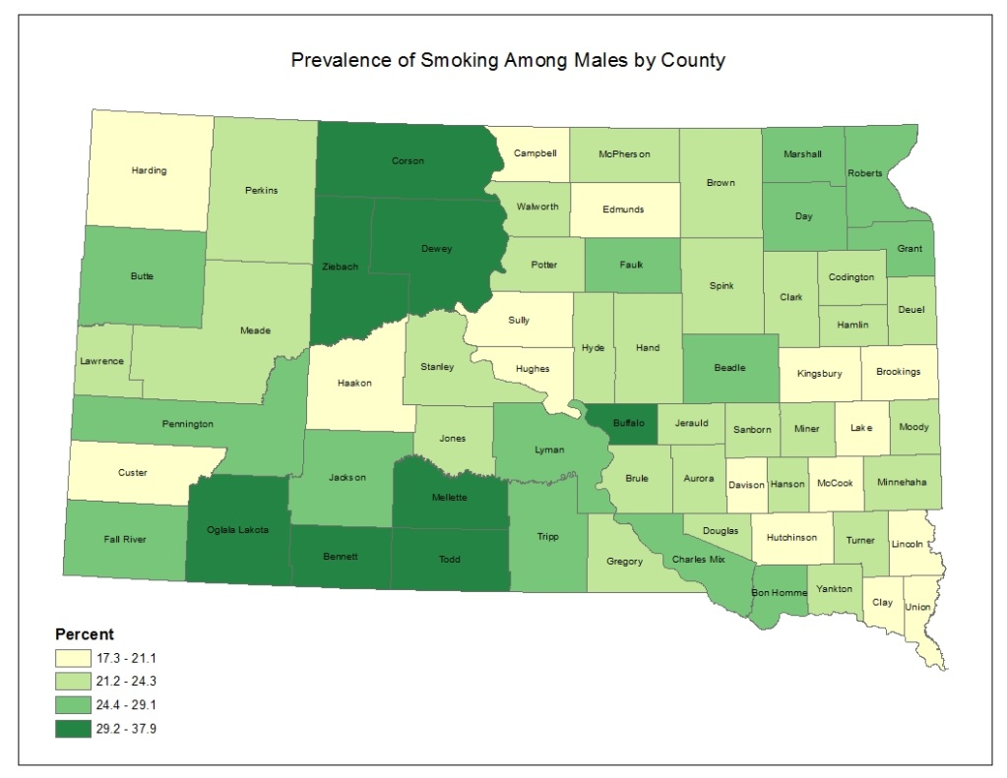

Slide 23
Strategies to Address Social Determinates of Health
Source: Robert Wood Johnson Foundation Commission to Build a Healthier America
Notes:
Health Impact Assessments to review needed , proposed, and existing social policies for their likely impact on health
Health in all policies which introduces improved health for all and the closing of health gaps as goals to be shared across all areas of government
Program examples: walking school bus, requiring PE,

Slide 24
QUESTIONS?

Slide 25
References
Robert Wood Johnson Foundation, Exploring the Social Determinants of Health. Issue Brief #1: What Shapes Health-Related Behaviors
Robert Wood Johnson Foundation, Commission to Build a Healthier America. Issue Brief 3: Neighborhoods and Health. September 2008
Robert Wood Johnson Foundation, Exploring the Social Determinants of Health. Issue Brief #4: Income, Wealth and Health
Robert Wood Johnson Foundation, Exploring the Social Determinants of Health. Issue Brief #5: Education and Health
Robert Wood Johnson Foundation, Exploring the Social Determinants of Health. Issue Brief #6: Race, Socioeconomic Factors and Health
Healthy People 2020 www.healthypeople.gov
South Dakota Department of Health, Behavioral Risk Factor Surveillance System
Institute for Health Metrics and Evaluation. www.healthdata.org/us-county-profiles
County Health Rankings www.countyhealthrankings.org

