Slide 1
Evaluating SOUTH DAKOTA quitline REACH AND TOBACCO CESSATION SUCCESS
Howard Wey, Presenter
Jenny Kerkvliet, Collaborator
Nancy Fahrenwald, Collaborator
Numerous UG Students, Collaborators
Funding Source: South Dakota Department of Health
Notes:
My thanks to the Pharmacy Department for inviting me to this work on the SD Quitline. I also want to thank and recognize the collaborators for this work. The SD Quitline is a program offered through the SD Department of Health and the data are managed by Jenny Kerkvliet of the Research Office of the College of Nursing, who also is actively involved in data analysis and interpretation. Nancy Fahrenwald is the former director of the Research Office and now Dean of the College of Nursing. There are also many students (who remain anonymous to me) that have been involved in data collection and entry. My role is primarily in data analysis and interpretation, and this talk is going to be about evaluation of tobacco cessation for different population groups in SD, and it will focus on approaches to data analysis and the influence of study design on conclusions about differences in tobacco cessation.

Slide 2
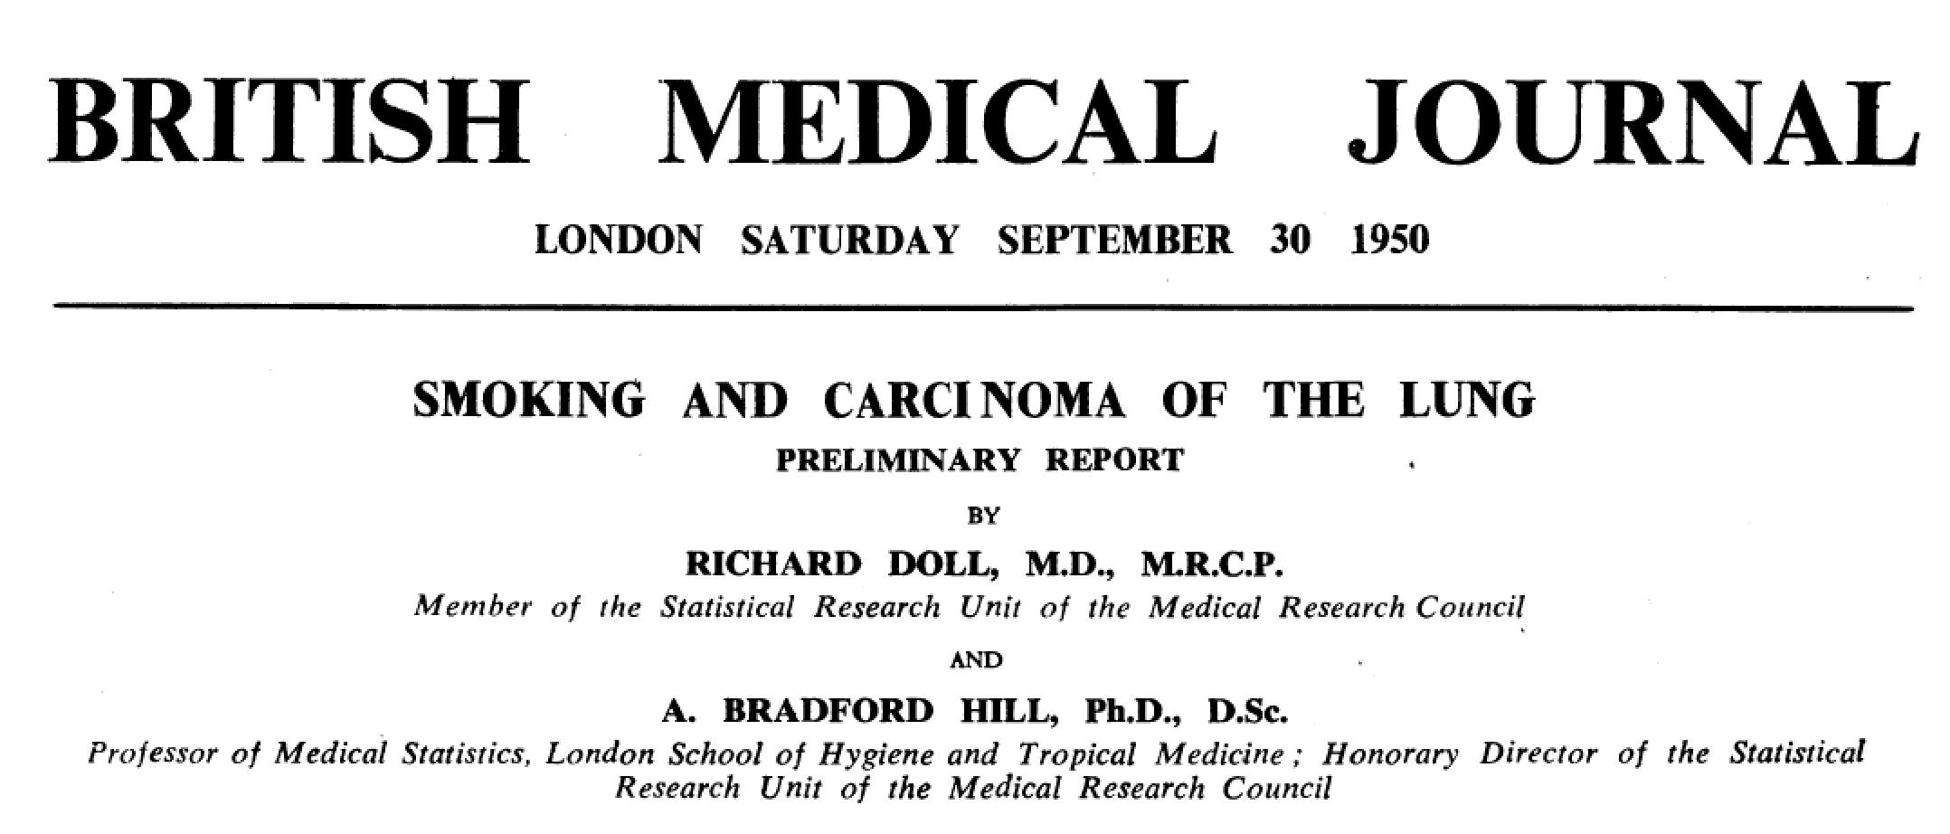
Recognition of a Problem
Notes:
One of the earliest studies designed (at the time) to provide strong evidence for a causal association between cigarette smoking and lung cancer was conducted in the UK by Richard Doll and Bradford Hill, a physician-epidemiologist and a statistician – a combination of talents that continues to be productive today.

Slide 3
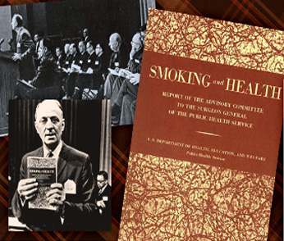
First Surgeon General’s Report, 1964
CDC: http://www.cdc.gov/features/2014smokingreport/
Notes:
50 year ago, in 1964, the 1st Surgeon General’s Report on Smoking and Health was released. The report used some of Bradford Hill’s “Criteria for Causality” in justifying a declaration the smoking was hazardous to human health. The decision was based primarily on data for males and the health outcome was lung cancer.

Slide 4
2014 Surgeon General’s Report on Smoking and Health
5.6 million children alive today will die prematurely from smoking if current smoking rates persist. That’s 1 in 13 children in this country.
The list of illnesses caused by smoking has grown and now includes diabetes, colorectal cancer, and liver cancer.
Smoking is now known to be a cause of rheumatoid arthritis and increase the risk for tuberculosis (TB) and death from TB.
Smoking raises the risk for impaired fertility, ectopic pregnancy, and cleft lip and cleft palate (birth defects) in babies of women who smoke during early pregnancy.
Smoking is linked to erectile dysfunction (impotence).
Smokers today have a greater risk of developing lung cancer than they did in 1964, even though they smoke fewer cigarettes.
CDC: http://www.cdc.gov/features/2014smokingreport/
Notes:
A point to make with this slide is that smoking has many adverse health effects. As our ability to discern subtle changes in biology advances, more subtle health effect can be identified.

Slide 5
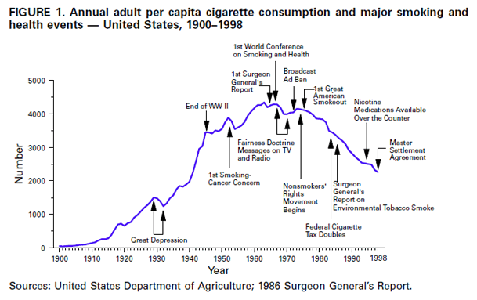
History of Cigarette Consumption
CDC: MMWR 48(43);986-993, 1999
Notes:
Once the adverse health effects of cigarette smoking was accepted by governments, regulation of cigarette smoking activities began. Activities such as advertisement, sales, package warnings, etc. In 1998, the Master Settlement Agreement with 46 states occurred, and this has provided funding for prevention and educational programs.

Slide 6
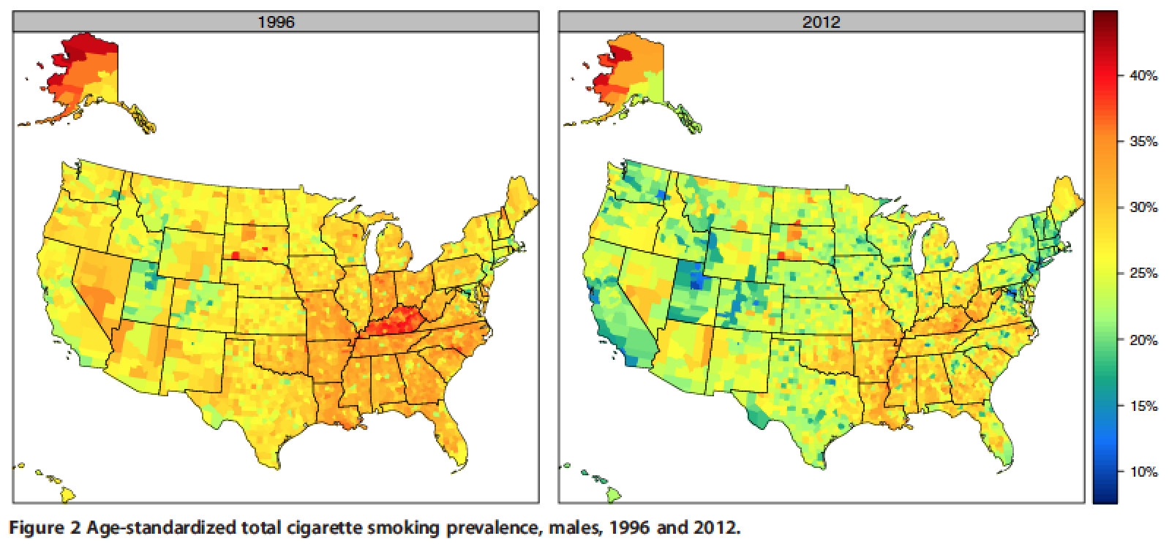
Cigarette Smoking Prevalence Over Time
Dwyer-Lindgren et al. Population Health Metrics 2014, 12:5
Notes:
County prevalence estimates for smoking prevalence based on BRFSS data. Over the past couple decades, smoking prevalence has significantly decreased. However, there are some counties were change has been very slow, or not occurred (see South Dakota).

Slide 7
South Dakota Tobacco Quitline
Toll-free telephone cessation service for tobacco users.
Participants are self-enrolled (98.4%) , but may be referred by a health provider.
Five proactive coaching sessions delivered by trained health coaches.
Includes optional free cessation products for an eight week period:
Nicotine Replacement Therapy (gum, patch, or lozenge)
Buproprion (Zyban)
Varenicline (Chantix)
Physician referral is required for prescription medications.
Participants requesting an NRT product are screened for known medical contraindications.
Medications are delivered in staggered increments following designated coaching sessions.

Slide 8
Tobacco Quitlines are Effective
Cochrane review of telephone counseling interventions.
Twelve studies (N = 30,182) that compared an intervention involving multisession proactive counseling with a control condition providing self-help materials or brief counseling at a single call showed evidence of a benefit from the additional support; RR = 1.38 95% CI = (1.28, 1.49).
Overall control quit rate was low: 7.6%.
In general, losses to follow-up were assumed to be continuing smokers.
Notes:
Cochrane reviews are systematic reviews of primary research literature using rigorous standardized process. A Cochrane review of telephone counseling interventions has been done, and the results indicate that telephone counseling has some effectiveness over limited assistance in increasing smoking cessation. Specifically, 12 studies were evaluated that compared an intervention involving multisession proactive counseling with a control condition providing self-help materials or brief counseling at a single call. The relative risk comparing telephone counseling to limited help was 1.38 with a 95% confidence interval of (1.28, 1.49). The RR is often interpreted to means that the probability of quitting smoking for smokers using telephone counseling is 38% greater than the probability for smokers getting minimal assistance.
Two key aspects of the studies included in the meta-analysis is that losses to follow-up were assumed to be continuing smokers, and (consequently) the overall control quit rate was low at 7.6%.

Slide 9
Investigation Using the SD Quitline Population
Objectives
Can a measure of reach be calculated and how does it vary across populations of smokers with different characteristics (gender, race, etc.)?
How do established measures of tobacco cessation vary by participant different characteristics (gender, race, etc.)?
Evaluate the independent associations of different participant characteristics with tobacco cessation (gender, race, etc.).
Evaluate the independent associations of different participant characteristics with loss to follow-up (gender, race, etc.).

Slide 10
SD Tobacco Users
~136,000 (2011-2012)
Enrollment 2011-2012 (N=12,107)
Exclusions (non-consent,
no complete coaching sessions,
one enrollment,
missing information; n=2,431)
Baseline Population (N=9,676)
Lost to follow-up (deceased,
invalid phone, refused,
unable to contact; n=4,671)
Contacted, but missing data
for tobacco cessation (n=20)
Follow-up Population (N=4,985)

Slide 11
Smoking and Quit Attempt Prevalence
Smoking Prevalence
Data from the 2011 and 2012 BRFSS surveys for questions that ask about current smoking.*
The number of current smokers divided by the size of the population in question.
Quit Attempt Prevalence
Data from the 2011 and 2012 BRFSS surveys for questions that ask about any attempt to quit smoking.*
The number of current smokers attempting to quit at least once in the past year divided by the size of the smoking population in question.
* Estimates using BRFSS data were calculated using the landline and cell phone combined final weights using Stata Statistical Software, v14.

Slide 12
2011-2012 SD Prevalence of Current Smoking
Characteristic | Prevalence (% with 95% CI)
Total | 22.5 (21.3, 23.7)
Gender Male Female | 24.5 (22.7, 26.4) 20.5 (19.0, 22.1)
Age (years) 18-29 30-39 40-49 50+ | 32.2 (28.9, 35.7) 28.2 (25.1, 31.5) 23.3 (20.4, 26.6) 15.7 (14.4, 17.1)
Race White American Indian Other | 19.9 (18.7, 21.1) 49.2 (44.2, 54.2) 32.4 (25.1, 40.7)
Education Less than High School High School, or G.E.D. Post-High School | 32.4 (28.1, 36.9) 28.6 (26.2, 31.0) 17.1 (15.8, 18.6)
Physical Health (days in last 30 with poor health) 0 days 1 to 19 days 20 to 30 days | 19.7 (18.3, 21.2) 26.9 (24.3, 29.7) 32.2 (28.1, 36.6)
Mental Health (days in last 30 with poor health) 0 days 1 to 19 days 20 to 30 days | 18.6 (17.3, 20.0) 28.1 (25.4, 30.9) 45.2 (39.4, 51.1)

Slide 13
2011-2012 SD Prevalence of Quit Attempt
Characteristic | Prevalence (% with 95% CI)
Total | 55.7 (52.5, 58.8)
Gender Male Female | 52.3 (47.9, 56.8) 59.6 (55.2, 63.9)
Age (years) 18-29 30-39 40-49 50+ | 65.2 (58.9, 71.0) 60.3 (53.7, 66.6) 42.3 (35.4, 49.6) 50.4 (45.6, 55.1)
Race White American Indian Other | 55.4 (51.9, 58.9) 57.0 (49.0, 64.5) 55.9 (40.5, 70.2)
Education Less than High School High School, or G.E.D. Post-High School | 50.9 (42.6, 59.2) 55.1 (50.0, 60.2) 57.9 (53.5, 62.2)
Physical Health (days in last 30 with poor health) 0 days 1 to 19 days 20 to 30 days | 53.5 (49.3, 57.5) 58.6 (52.5, 64.4) 59.8 (51.6, 67.5)
Mental Health (days in last 30 with poor health) 0 days 1 to 19 days 20 to 30 days | 51.9 (47.8, 56.1) 62.5 (56.6, 68.1) 57.5 (48.5, 66.1)

Slide 14
Distribution of Race Among Smokers Overall, with Quit Attempts, and Contacting QuitLine

Slide 15
Promotional Reach Measure*
The percent of SD smokers that call the quitline was estimated and used as a measure of reach (promotional reach).
The denominator was estimated using BRFSS data for specific subpopulation groups such as race.
The numerator is obtained from quitline intake data for callers that complete the intake questionnaire and are smokers.
* Promotional reach is a measure recommended by the North American Quitline Consortium (NAQC).

Slide 16
2011-2012 SD QuitLine Promotional Reach
Characteristic | Male* | Female* | Both Genders*
Total | 2.7 (2.5, 3.0) | 4.6 (4.2, 5.0) | 3.6 (3.4, 3.8)
Age (years) 18 to 29 30 to 39 40 to 49 50+ | 2.2 (1.8, 2.6) 3.1 (2.6, 3.8) 3.5 (2.9, 4.5) 2.6 (2.3, 3.0) | 4.0 (3.4, 5.0) 4.5 (3.7, 5.5) 5.2 (4.3, 6.5) 4.8 (4.2, 5.5) | 3.0 (2.6, 3.4) 3.8 (3.3, 4.3) 4.3 (3.8, 5.1) 3.6 (3.3, 4.0)
Race White American Indian Other | 3.0 (2.8, 3.4) 1.2 (1.0, 1.5) 2.0 (1.4, 3.3) | 5.2 (4.8, 5.8) 1.9 (1.6, 2.5) 3.4 (2.4, 5.8) | 4.0 (3.8, 4.3) 1.6 (1.4, 1.9) 2.4 (1.8, 3.5)
Education Some college or higher High school diploma/GED Less than high school | 3.1 (2.7, 3.5) 2.6 (2.3, 3.0) 2.2 (1.7, 2.8) | 5.2 (4.6, 5.9) 4.4 (3.8, 5.2) 3.2 (2.6, 4.1) | 4.1 (3.8, 4.5) 3.3 (3.0, 3.7) 2.6 (2.3, 3.2)
* % of current SD smokers (95% CI)

Slide 17
Tobacco-Use Cessation Measures
Self–reported tobacco use abstinence question: Have you smoked any cigarettes or used other tobacco, even a puff or a pinch, in the last 30 days?
This question is asked about 7-months after enrollment and used to calculate 30 day point prevalence (30 dpp).
“Intent to Treat” (ITT) Quit Rate: The 30 dpp in the baseline population that assumes everyone lost to follow-up did not quit.
“Responder” (RES) Quit Rate: The 30 dpp in the follow-up population.

Slide 18
ITT versus Responder Quit Rate
Baseline Population
Follow-up Population (50% Response)
ITT QR = 5/36 = .14
RES QR = 5/18 = .28
True (unknown) QR = 10/36 = .28
Loss to Follow-up
(random)
Dropout (unknown) QR = 5/18 = .28

Slide 19
ITT versus Responder Quit Rate
Baseline Population
Follow-up Population (50% Response)
ITT QR = 8/36 = .22
RES QR = 8/18 = .44
True (unknown) QR = 10/36 = .28
Loss to Follow-up
(quitters are less
likely to be lost)
Dropout (unknown) QR = 2/18 = .11
Notes:
People that quit are less likely to dropout

Slide 20
ITT versus Responder Quit Rate
Baseline Population
Follow-up Population (50% Response)
ITT QR = 2/36 = .06
RES QR = 2/18 = .11
True (unknown) QR = 10/36 = .28
Loss to Follow-up
(quitters are more
likely to be lost)
Dropout (unknown) QR = 8/18 = .44

Slide 21
Influence of Response Rate on a Quit Rate
Use a different response rate and assume people that quit are less likely to dropout.
Baseline Population
Follow-up Population (33% Response)
ITT QR = 6/36 = .17 (vs. .22)
RES QR = 6/12 = .50 (vs. .44)
True (unknown) QR = 10/36 = .28
Loss to Follow-up
Dropout (unknown) QR = 4/24 = .17
(vs. .11)
Notes:
A decrease from 50% to 33% eliminated more smokers than non-smokers from the follow-up population.

Slide 22
Data on Response Rates and Quit Rates
The differences of ITT and RES QR’s from the TRUE QR depend on the DROPOUT QR and it’s relationship to the response rate.
People that quit are less likely to drop out, and can lead to selection bias.
The ITT and RES QR’s appear to provide bounds for the TRUE QR.
NAQC: Measuring Quit Rates. Quality Improvement Initiative, L. An, et al., 2009
Notes:
NAQC: North American Quitline Consortium

Slide 23
Influence of Differential Response Rates
Assume QR_{R} = QR_{B} and similar relationship of QR and response rate, and the response rate for B is less than for R, then
RES QR_{B} > RES QR_{R}
ITT QR_{B} < ITT QR_{R}
Notes:
Another issue related to bias arises when quit rates for two populations are compared and the response rates are different for the two populations.

Slide 24
Response Rates
Characteristic | Response Rate % of 9,676 | P-Value
Age (years) < 30 30 to 40 40 to 50 ≥ 50 | 41.5 47.9 51.4 61.9 | <0.01
Gender Male Female | 53.9 49.5 | <0.01
Race White American Indian Other | 52.9 38.8 38.9 | <0.01
Mental Health Condition Yes No | 46.4 52.4 | <0.01
Notes:
Differences everywhere

Slide 25
Quit Rates* by Demographic Characteristics
Characteristic | ITT QR | P-Value | RES QR | P-Value
Age (years) < 30 30-40 40-50 ≥ 50 | 17.4 22.1 22.7 26.2 | <0.01 | 41.8 46.2 44.1 42.3 | 0.14
Gender Male Female | 24.4 20.6 | <0.01 | 45.4 41.6 | 0.01
Race White American Indian Other | 23.1 15.1 16.4 | <0.01 | 43.7 39.0 42.2 | 0.38
Education Some college or higher High school diploma/GED Less than high school | 24.0 21.9 16.4 | <0.01 | 38.7 44.3 43.6 | 0.09
*For any tobacco use.
Notes:
Females are more likely to dropout than males; Am. Indians are more likely to dropout than Whites; Younger people are more likely to dropout; People with less education are more likely to dropout.

Slide 26
Quit Rates* by Demographic Characteristics
Characteristic | ITT QR | P-Value | RES QR | P-Value
Receiving Medicaid benefit Yes No | 15.9 23.3 | <0.01 | 35.6 44.4 | <0.01
Mental Health Condition Yes No | 16.8 23.3 | <0.01 | 36.3 44.5 | <0.01
Other Health Condition Yes No | 24.7 21.3 | <0.01 | 43.9 43.2 | 0.60
Duration of Tobacco Use 0 to 5 years 6 to 10 years 10 or more years | 17.6 20.3 23.0 | <0.01 | 42.1 44.4 43.4 | 0.83
*For any tobacco use.
Notes:
People on Medicaid are more likely to dropout.

Slide 27
Many Factors May Influence Tobacco Cessation and Loss to Follow-Up
All the demographic factors presented may potentially influence the success of tobacco cessation and loss to follow-up.
Bivariate associations are likely to be confounded.
Use of multiple logistic regression to evaluate multivariate associations helps avoid confounding.
The multivariate association is described by an adjusted (multivariate) odds ratio.
Example: An adjusted OR for mental health condition in the baseline population is 0.76 with 95% CI = (0.65, 0.90). This is interpreted as persons with a (self-reported) mental health condition being 24% less likely to have answered yes to the smoking cessation question than persons without a mental health condition, all other factors in the analysis being constant (it doesn’t matter what a persons age is, etc.).

Slide 28
Multivariate Odds Ratios for Tobacco Cessation
Characteristic | Baseline* | Follow-up*
Age (Range, 16 to 84 years) | 1.01 (1.01, 1.02) | 1.00 (0.99, 1.00)
Gender Male Female | 1.0 0.87 (0.79, 0.97) | 1.0 0.96 (0.85, 1.08)
Race Caucasian American Indian Other | 1.0 0.66 (0.52, 0.84) 0.74 (0.55, 0.99) | 1.0 0.89 (0.67, 1.17) 0.98 (0.69, 1.39)
Education Some college or higher High school diploma/GED Less than high school | 1.0 0.90 (0.81, 0.99) 0.69 (0.58, 0.82) | 1.0 1.05 (0.93, 1.18) 0.90 (0.73, 1.11)
Mental Health Condition | 0.76 (0.65, 0.90) | 0.75 (0.63, 0.90)
Medicaid | 0.71 (0.60, 0.84) | 0.76 (0.63, 0.92)
Physical Health Condition | 1.00 (0.89, 1.12) | 1.00 (0.87, 1.15)
* Parentheses contain the 95% confidence interval

Slide 29
Multivariate Odds Ratios for Loss to Follow-Up
Characteristic | OR (95% CI)*
Age (Range, 16 to 84 years) | 0.97 (0.97, 0.98)
Gender Male Female | 1.0 1.18 (1.08, 1.29)
Race Caucasian American Indian Other | 1.0 1.56 (1.29, 1.87) 1.54 (1.21, 1.95)
Education Some college or higher High school diploma/GED Less than high school | 1.0 1.25 (1.14, 1.38) 1.47 (1.27, 1.41)
Mental Health Condition | 1.06 (0.93, 1.21)
Medicaid | 1.21 (1.06, 1.38)
* Based on the Baseline Cigarette Population (N=8,703), which includes all cigarette only callers at baseline having complete data on covariates.

Slide 30
Summary
RACE
The race distribution for smokers at intake in the SD QuitLine from 2011 to 2012 when compared to the previous two distributions suggests the American Indian population underutilizes the SD QuitLine.
The promotional reach measure suggests White smokers have approximately 2.5 times greater use of the SD QuitLine than American Indians.
An evaluation of quit rates for SD quitline population in 2011 and 2012 suggest that American Indians have from an 11% to 35% lower success in quitting tobacco use than Whites.
American Indian smokers enrolled in the QuitLine were 56% more likely to not respond to the follow-up conducted by the SD QuitLine program 7 months after the start of the program.

Slide 31
Summary
MENTAL HEALTH CONDITION
The comparisons of persons with a mental health condition to those without are similar for both the baseline and follow-up populations, which suggests that there is minimal bias from the loss to follow-up. The situation is similar for Medicaid.
For the quitline population, persons with a mental health condition are about 25% less likely to stop smoking than persons without a mental health condition. The situation is similar for Medicaid.
The associations of a MHC and Medicaid are independent of each other, suggesting persons with both factors may have greater difficulty quitting tobacco.

Slide 32
THE END! THANKS!

