Slide 1
State Plan Updates

Slide 2
GOAL 2
Encourage the adoption of policies that make health a priority.

Slide 3
Model Policies
2.1: Develop a set of 10 model policies related to chronic disease.
Workgroup Members:
DeEtta Dugstad Denise Kolba
Jennifer McDonald Megan Hlavacek
Kari Senger Vicki Palmreuter
Mary Michaels Megan Olesen
Neal Nachtigall Sue Johannsen
Pamela Schochenmaier Lori Oster
Roberta Hofeldt Fran Rice
Sandra Melstad Robin Arends
Sarah Quail Melissa Coull
Laura Harmelink Jamie Seiner
Nancy Beaumont
Lexi Haux
Dr. Mary Milroy
Dr. David Basel
Danielle Hamann

Slide 4
MODEL POLICY ACCESS
http://goodandhealthysd.org/

Slide 5
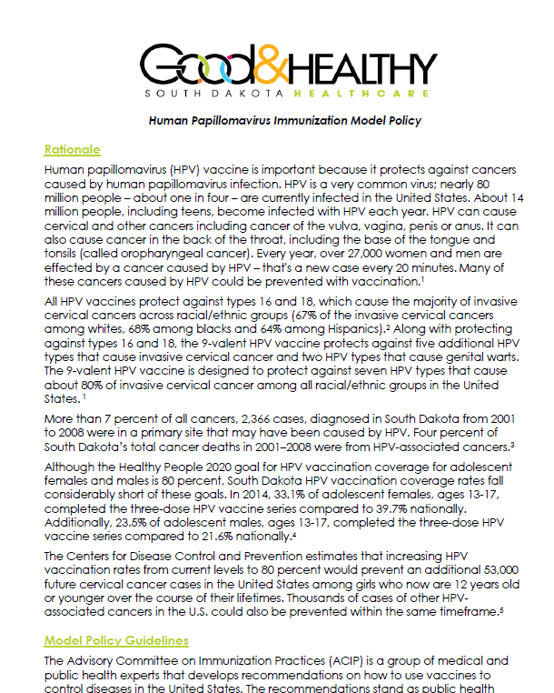
Human Papillomavirus Immunization Model Policy
Rationale
Model Policy Guidelines
routinely recommended vaccine; same way, same day; subsequent appointments; reminder systems; etc.
Implementation
evidence-based interventions
Compliance
Final Statement
Definitions
Resources
References

Slide 6
Better Choices, Better Health® South Dakota Chronic Disease Self-Management Program Referral Policy
Rationale
Chronic disease statistics warrant intervention
Model Policy Guidelines
Referral from electronic health record, prescribed by provider
Implementation
Integrate referral into clinic workflow
Promote program, i.e. patient
portal email messages to patients
Compliance
Quality measures
Managed care

Slide 7
Success Stories
2.3: Document and disseminate 10 success stories related to health policies in SD settings.

Slide 10
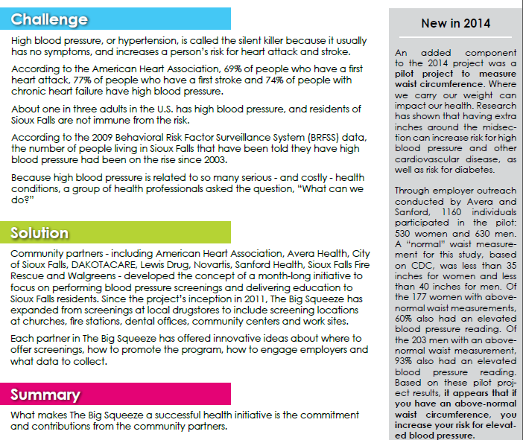

Slide 11
GOAL 3
Make local data and evidence-based best practices readily available to community leaders.

Slide 12
Quarterly Informational Briefs
Workgroup Members:
Ashley Miller Sue Johannsen
Sandra Melstad Tori Whipple
Katie Hill Stacie Fredenburg
Mary Michaels Lexi Haux
Danielle Hamann Tracy Bieber
Lindsay Stern
Rachel Haigh-Blume
Raylene Miner
Robin Arends
David Basel
Jennifer McDonald
Nancy Beaumont
Neal Nachtigall
3.2: Develop and disseminate quarterly informational briefs highlighting chronic disease prevention data and action recommendations to statewide community leaders and stakeholders.

Slide 13
About the Infographics
Cover a number of chronic diseases and related risk factors
Topics are decided by a vote of the workgroup

Slide 14
Where to Find the Infographics
http://goodandhealthysd.org/about/key-data/

Slide 15
3.3 In partnership with local community leaders and stakeholders, provide local chronic disease data and action recommendations to at least three [one large (10,000+ population), one small (<10,000 population) and one tribal] communities per year.

Slide 16
State Plan Partner Support
American Cancer Society
Arthritis Foundation
Great Plains Tribal Chairmen’s Health Board
Sanford Health Plan
South Dakota Dental Association
SD DOH
South Dakota State Parks
YMCA of Rapid City

Slide 17
Action to Date
Outreach to statewide agencies and organizations to determine a need for local chronic disease data and action recommendations.
Ongoing discussion with state chronic disease epidemiologist to identify additional strategies to support communities.
Review of literature to identify evidence-based practices and recommendations to support data needs in communities.
Survey of Grant Training Workshop Participants to assess data needs.
Notes:
Organizations
SDSU Extension
SD DOH Leadership Team and Collaborative
Great Plains Tribal Chairmen’s Health Board
South Dakota Foundation for Medical Care

Slide 18
Type of support coalition needs regarding data to guide coalition efforts.
Source: Community Coalition Grant Workshop Participant, 2016 (N=14)
Notes:
The Department of Health would like to understand how they can further support coalitions in South Dakota regarding data.
Please identify what type of support your coalition needs regarding data to guide coalition efforts.

Slide 19
If a "Data Concierge" was made available to coalitions in South Dakota, would this be a service you would utilize?
Source: Community Coalition Grant Workshop Participant, 2016 (N=14)
Notes:
The Department of Health is exploring the establishment of a "Data Concierge“ service to assist communities in South Dakota with collecting project specific data as well as providing analysis and interpretation of the data.

Slide 20
Next Steps
Evaluate Chronic Disease Partner’s Meeting Participants data needs
Questions or Follow-up
Sandra Melstad
Slmelstad.consulting@gmail.com

Slide 21
Goal 4
Implement evidence-based programs for individuals to prevent and manage their chronic diseases.

Slide 22
Evidence-Based Chronic Disease Lifestyle Change Programs
4.1: Increase the number of sites offering evidence-based chronic disease lifestyle change programs in community settings from 2 to 20.

Slide 23
Better Choices, Better Health®SD
South Dakota’s Chronic Disease Self-Management Program

Slide 24
BCBH Network
Comprised of the Leadership Team, Master Trainer Outreach Ambassadors, Regional Contacts, Lay Leaders, Master Trainers, Action Committee Members, and Advisory Council Members.
The PURPOSE - common goals of implementing, scaling, embedding, and sustaining chronic disease self-management education.
The INTENTION - collaboratively adopt best practices and standards that create a shared road map and opportunities toward reaching our common goals.
The MISSION - promote the expansion, implementation, coordination, and sustainability of a quality, statewide chronic disease self-management program.
The VISION - improve the chronic disease health of South Dakotans by positively impacting quality of life, promoting access to care, and reducing health care costs.
Notes:
Primary mechanism by which future plans, activities, tools, and resources for BCBH SD are discussed, developed, and implemented.
It is our hope and intent that those participants who have CDSM training are now becoming proactive and more focused on being as healthy as possible, and are more adequately prepared to be an active manager in their own health care.

Slide 25
BCBH Network Numbers
4 Master Trainer Outreach Ambassadors
8 statewide Regional Contacts (W, N, E, S, Central, and Tribal)
19 Master Trainers
52 Lay Leaders
6 Action Committees
1 Advisory Council (27 members)

Slide 26
BCBH Data
Location | 2016 | 2015 | 2014
Aberdeen | 0 | 1 | 1
Brookings | 2 | 0 | 0
Custer | 0 | 1 | 1
Hartford | 0 | 1 | 0
Hermosa | 1 | 0 | 0
Huron | 1 | 1 | 1
Mitchell | 1 | 1 | 0
Pierre | 1 | 2 | 1
Rapid City | 4 | 4 | 3
Sioux Falls | 9 | 9 | 3
Sisseton | 0 | 0 | 1
Spearfish | 1 | 0 | 0
Sturgis | 1 | 0 | 0
Watertown | 1 | 1 | 0
Totals | 22 | 21 | 11
Number of workshops offered since beginning 54
Program – September 2014 to July 1, 2016
54 BCBH Workshops (Oct 2014-July 2016)
8.9 - Average participants per workshop
479 attenders
324 completers (68%)
Grant - September 1, 2015 to July 1, 2016
208 completers /301 attenders [Y1 goal is 225 completers]
69% completion rate [Y1 goal is 68%]
Notes:
Year 1 (sept 2015-Aug 2016) BCBH goal was to reach 224 in the state- with 2 months remaining, we are at 208.

Slide 27
BCBH Future Plans
Launch of BCBH SD on-line workshops
Program Expansion (Lay Leader training in tribal communities, pilot regularly scheduled workshops, healthcare referral policy, use of social media)
BCBH Workplan – posted on BCBH website

Slide 28
National Diabetes Prevention Program
Lifestyle change program for the prevention of Type 2 diabetes

Slide 29
What is the National DPP?
Lifestyle change program by CDC
Prevention of Type 2 diabetes
Eligibility:
Prediabetes: higher than normal blood sugar
Risk factors
58%–71% reduction in risk
Community Guide recommended
Type 2 Diabetes
Prediabetes
Normal

Slide 30
National DPP in South Dakota 2015
7 locations

Slide 31
Outcomes Data
2015 Calendar Year
Data from 5 sites*
62 participants at start
58 participants, 5% average weight loss, 8 sessions, 622 pound weight loss collectively
17 participants, 7% average weight loss, program completion
Courtesy of the South Dakota Diabetes Coalition
* Evaluation conducted by the South Dakota Diabetes Coalition

Slide 32
National DPP in South Dakota 2016
10 locations

Slide 33
Successes
“I’m in my 50s and still don’t have diabetes. Every year I can put that off is an achievement. It’s one of my health goals, and I am glad this program stands with me on that important point.”—Past participant

Slide 34
4.2: Promote comprehensive chronic disease patient navigation services by providing annual training and technical assistance.
Cancer Survivorship and Navigation Training hosted May 20th in Sioux Falls
Topics covered:
review of patient navigation
survivorship care guidelines
cancer screening guidelines
evidence-based strategies to improve cancer screening and lifestyle habits
the importance of survivorship care planning and review of required Commission on Cancer data elements that must be included in a survivorship care plan
Presented by: GW Cancer Institute
25 Participants in Attendance

Slide 35
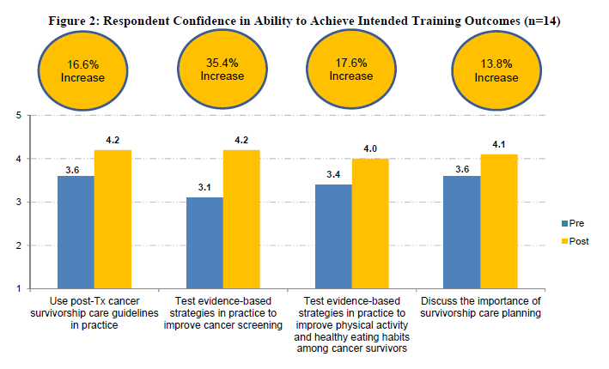

Slide 36
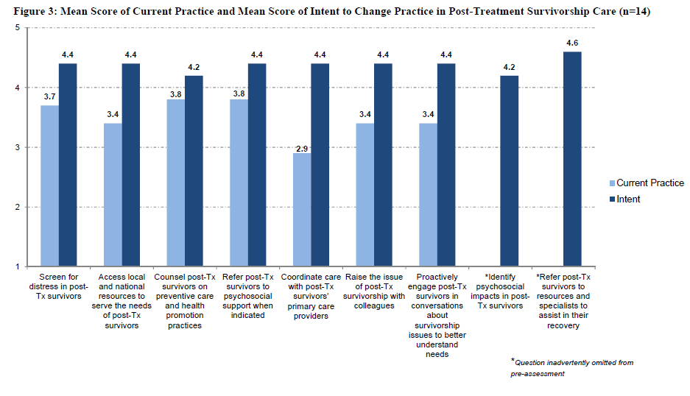

Slide 37
Goal 5
Increase access to chronic disease prevention, screening and treatment.

Slide 38
The Cost Savings of Investing in Chronic Disease Prevention and Health Promotion A White Paper
5.1: The Chronic Disease Coalition will develop a white paper describing cost savings related to prevention.

Slide 39
Writing Team
Sandra Melstad (SLM Consulting)
Dee Dee Dugstad (DOH)
Melissa Coull (DOH)
Ashley Miller (DOH)
Denise Kolba (SD Foundation for Medical Care)
Mary Michaels (Sioux Falls Health Department)
Neal Nachtigal (Sanford Health)
Keri Thompson (Delta Dental)

Slide 40
Topics
Cost of Chronic Disease to Community Health
By 2030, the cost for SD to treat chronic disease is estimated to be $466.5 billion annually.
Long-term Cost savings of Investing in a Healthy Community
Big Squeeze: number of individuals with normal blood pressure
number of those at risk
Effectiveness of Prevention Strategies and factors that Impact Quality of Life in SD
Workplace Wellness- Falcon Plastics reduced the number of employee members with 2 or more risk factors from 80% to 39%
Walkable, bikeable communities
Socioeconomic Impact on Health
School Health
Next Steps
Community
Evidence-based Strategies- Better Choices Better Health

Slide 41
5.2 Promote the adoption of evidence-based team-centered approaches to chronic disease treatment and prevention by providing annual training.

Slide 42
Goal 6
Increase Access to quality chronic disease prevention and screening.

Slide 43
Worksite Wellness
6.2: Increase the number of employers sponsoring worksite wellness programs from 150 to 350.
Workgroup members:
Mary Michaels
Debbie Lancto
Amy Gould
Bridget Munterfering
Megan Hlavacek
Kandy Jamison
Lacey Seefeldt
Trisha Dohn
Jennifer McDonald
Sara Hornick
Theresa Ferdinand
Trisha Dohn
Vicki Palmreuter

Slide 44
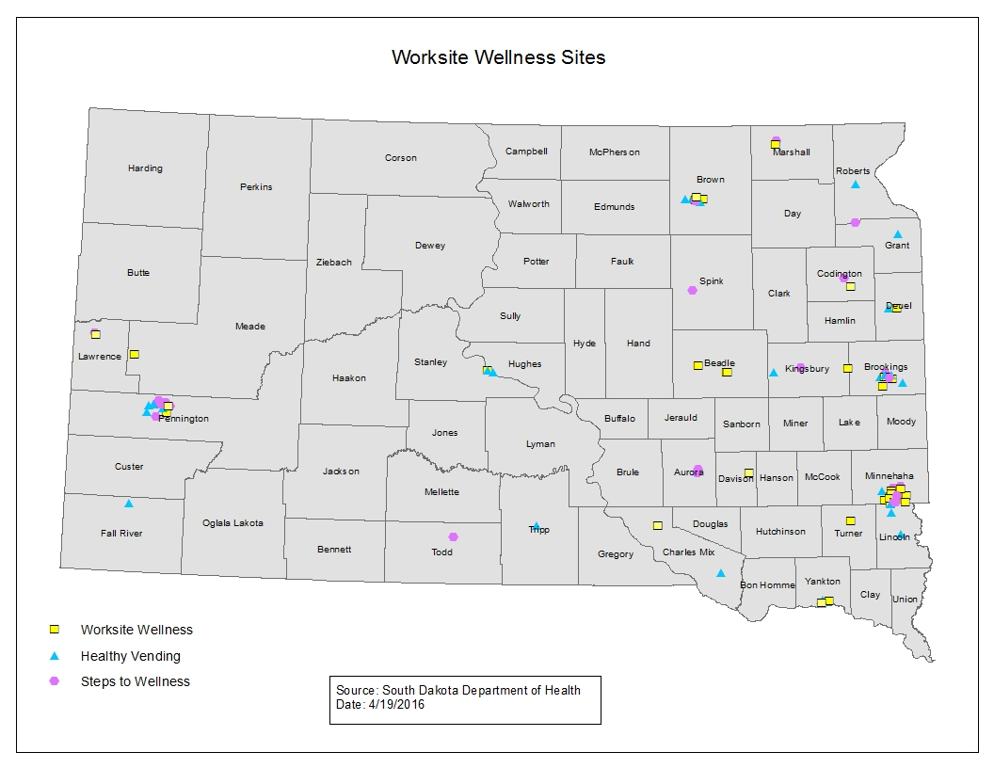

Slide 45
Goal 11
Expand programs for communities to improve access to healthy foods.

Slide 46
11.1: Increase the number and type of food retail venues that sell healthier food options and the number of community members who have access to retail venues that sell healthier food options for residents living in counties where greater than 40% of adults are obese.

