Slide 1
Rapid City Community Walk Audit
Sara Hornick
YMCA
Community Engagement Director

Slide 2
Overview
Fast Facts
Media
Leaders
Volunteers
Routes
Walking months
Scoring Process
Results

Slide 3
Fast Facts
May 2014 through May 2015 – grant period
Over 100 volunteers
11 walking routes throughout Rapid City
3 walking months
Results utilized in the future planning process

Slide 4
Media
Press release as soon as grant was awarded
Spoke with local news entities about grant process, outcomes, etc.
Flyers were distributed around Rapid City to local businesses
Created a Facebook “Like” page
Shared news stories, examples of great and poor walking conditions, general updates about the Rapid City walk audits

Slide 5
Press Release & Flyer

Slide 6
Leaders
10 leaders to facilitate walks
Most leaders changed routes each walking month
Each lead a group of about 6-8 walkers throughout a route
Each walk was about 1-1 ½ long
The leader decided on dates and times for walk
The leader and walkers met at a predesignated location along the route

Slide 7
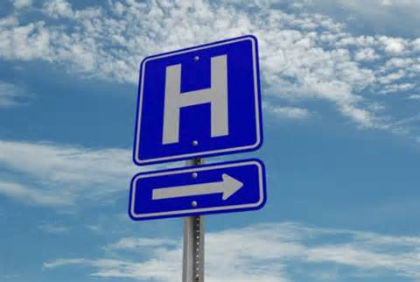
Volunteers
Rapid City gathered over 100 volunteers to participate with the walk audits
Included all demographics and specialized populations
Some volunteers include…

Slide 8
Routes
11 routes were created throughout the City of Rapid City
Each route about 1-1 ½ miles long
Each route created to walk around a block
Never had to walk the same street twice during a walk
Bicycle and pedestrian crash data was reviewed and routes were created around high incident areas
Routes were created around points of interest
YMCA
Feeding South Dakota
Civic Center
Downtown locations
Apartment complexes
Safeway grocery store
Employment areas
Youth & Family Services

Slide 9
Crash Data & Sidewalk Inventory

Slide 10
All Routes

Slide 11
Walking Months
3 walking months
September, October and December
Purpose of having three walking months
Gather an average score
Gather opinions from more walkers – walkers completed different routes each month
Identify challenges during different times of the year (i.e. weather conditions affecting walking conditions)

Slide 12
Scoring Process
4 stops along each route
Each stop the leader reviewed the questions on the score sheet and asked the participants how they would score the segment that was just walked
Having 4 stops allowed for specific results – not generalized
There were routes with one segment that had awful walking conditions and one segment that had ideal walking conditions – we wanted to avoid generalizations while reviewing score sheets

Slide 13
Score Sheet

Slide 14
Results
The score sheets were compiled and averaged
The final report and results are used in the Rapid City Community Planning and Engineering departments while reviewing development applications that are along a walk audit route
The final report was approved by the Rapid City Council
Utilized as a reference and planning document

Slide 15
Kansas City Street

Slide 16
Another view of Kansas City St.

Slide 17
Countdown Timer

Slide 18
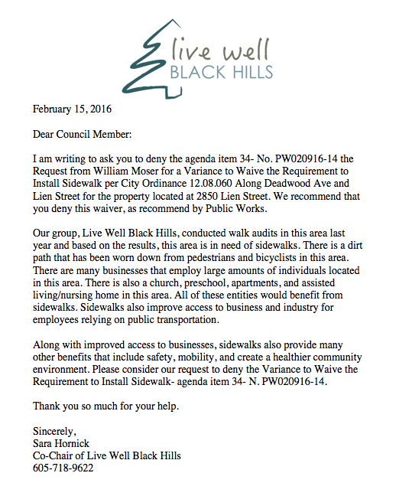

Slide 19
Advocacy

Slide 20
Example of Final Results
Maps like this one were created for each question in the final report

