Slide 1
Walking the Walk, Talking the Talk: Utilizing Walk Audits
BURKE
Ann Schwader, Nutrition Field Specialist
July 26, 2016

Slide 2
Burke Demographics
Gregory County, SD: 4,217
Burke, SD: 604
County poverty rate: 19.2 %
State rate: 14.1 %
Nat’l rate: 15.0 %
Gregory County, 10% of adults report fair or poor health, 30% are obese, and 32% are inactive
2014

Slide 3
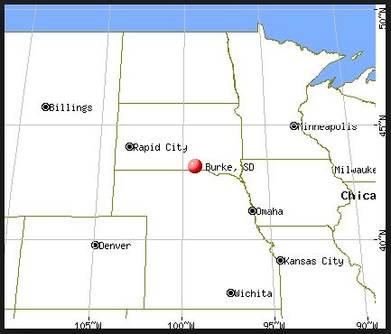
Burke Demographics
2014

Slide 4
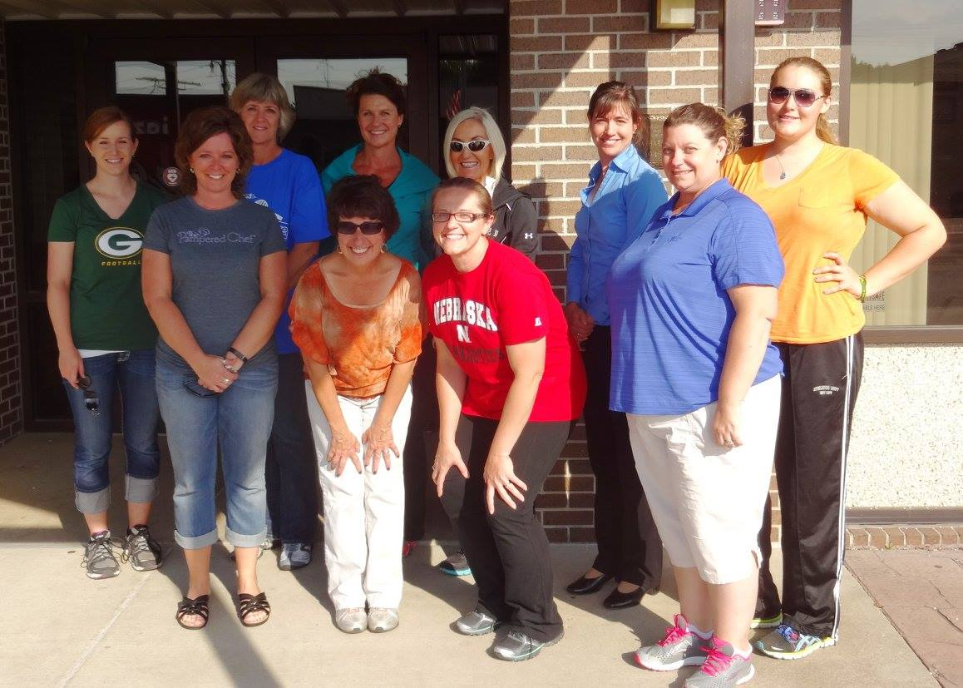
Burke Wellness Coalition’s Mission:
"We are committed to helping Burke create and sustain environments that support healthy lifestyles."

Slide 5
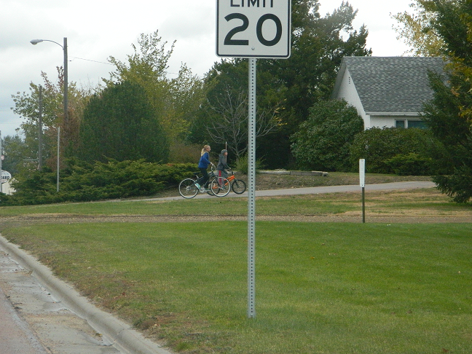
Need for Walk Audit Grant
(Photo: Burke, SD)

Slide 6
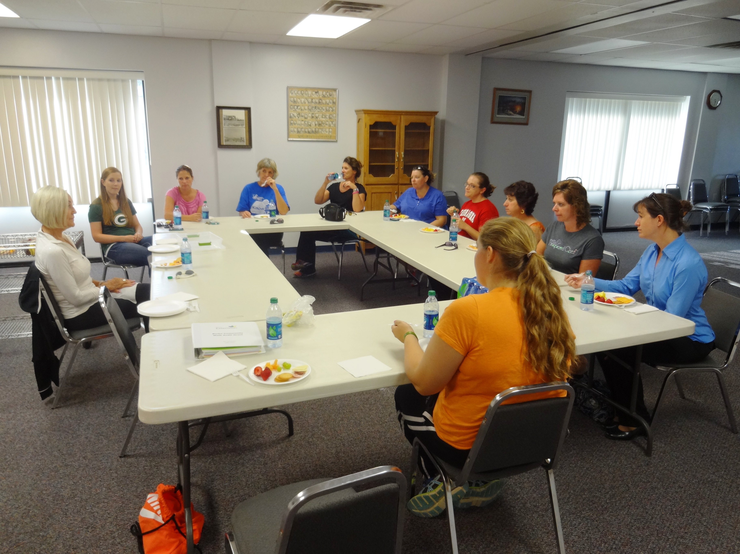
Active Lifestyle Workshop
Burke Civic Center, Burke, SD

Slide 7
Active Lifestyle Workshop
Burke Civic Center, Burke, SD

Slide 8
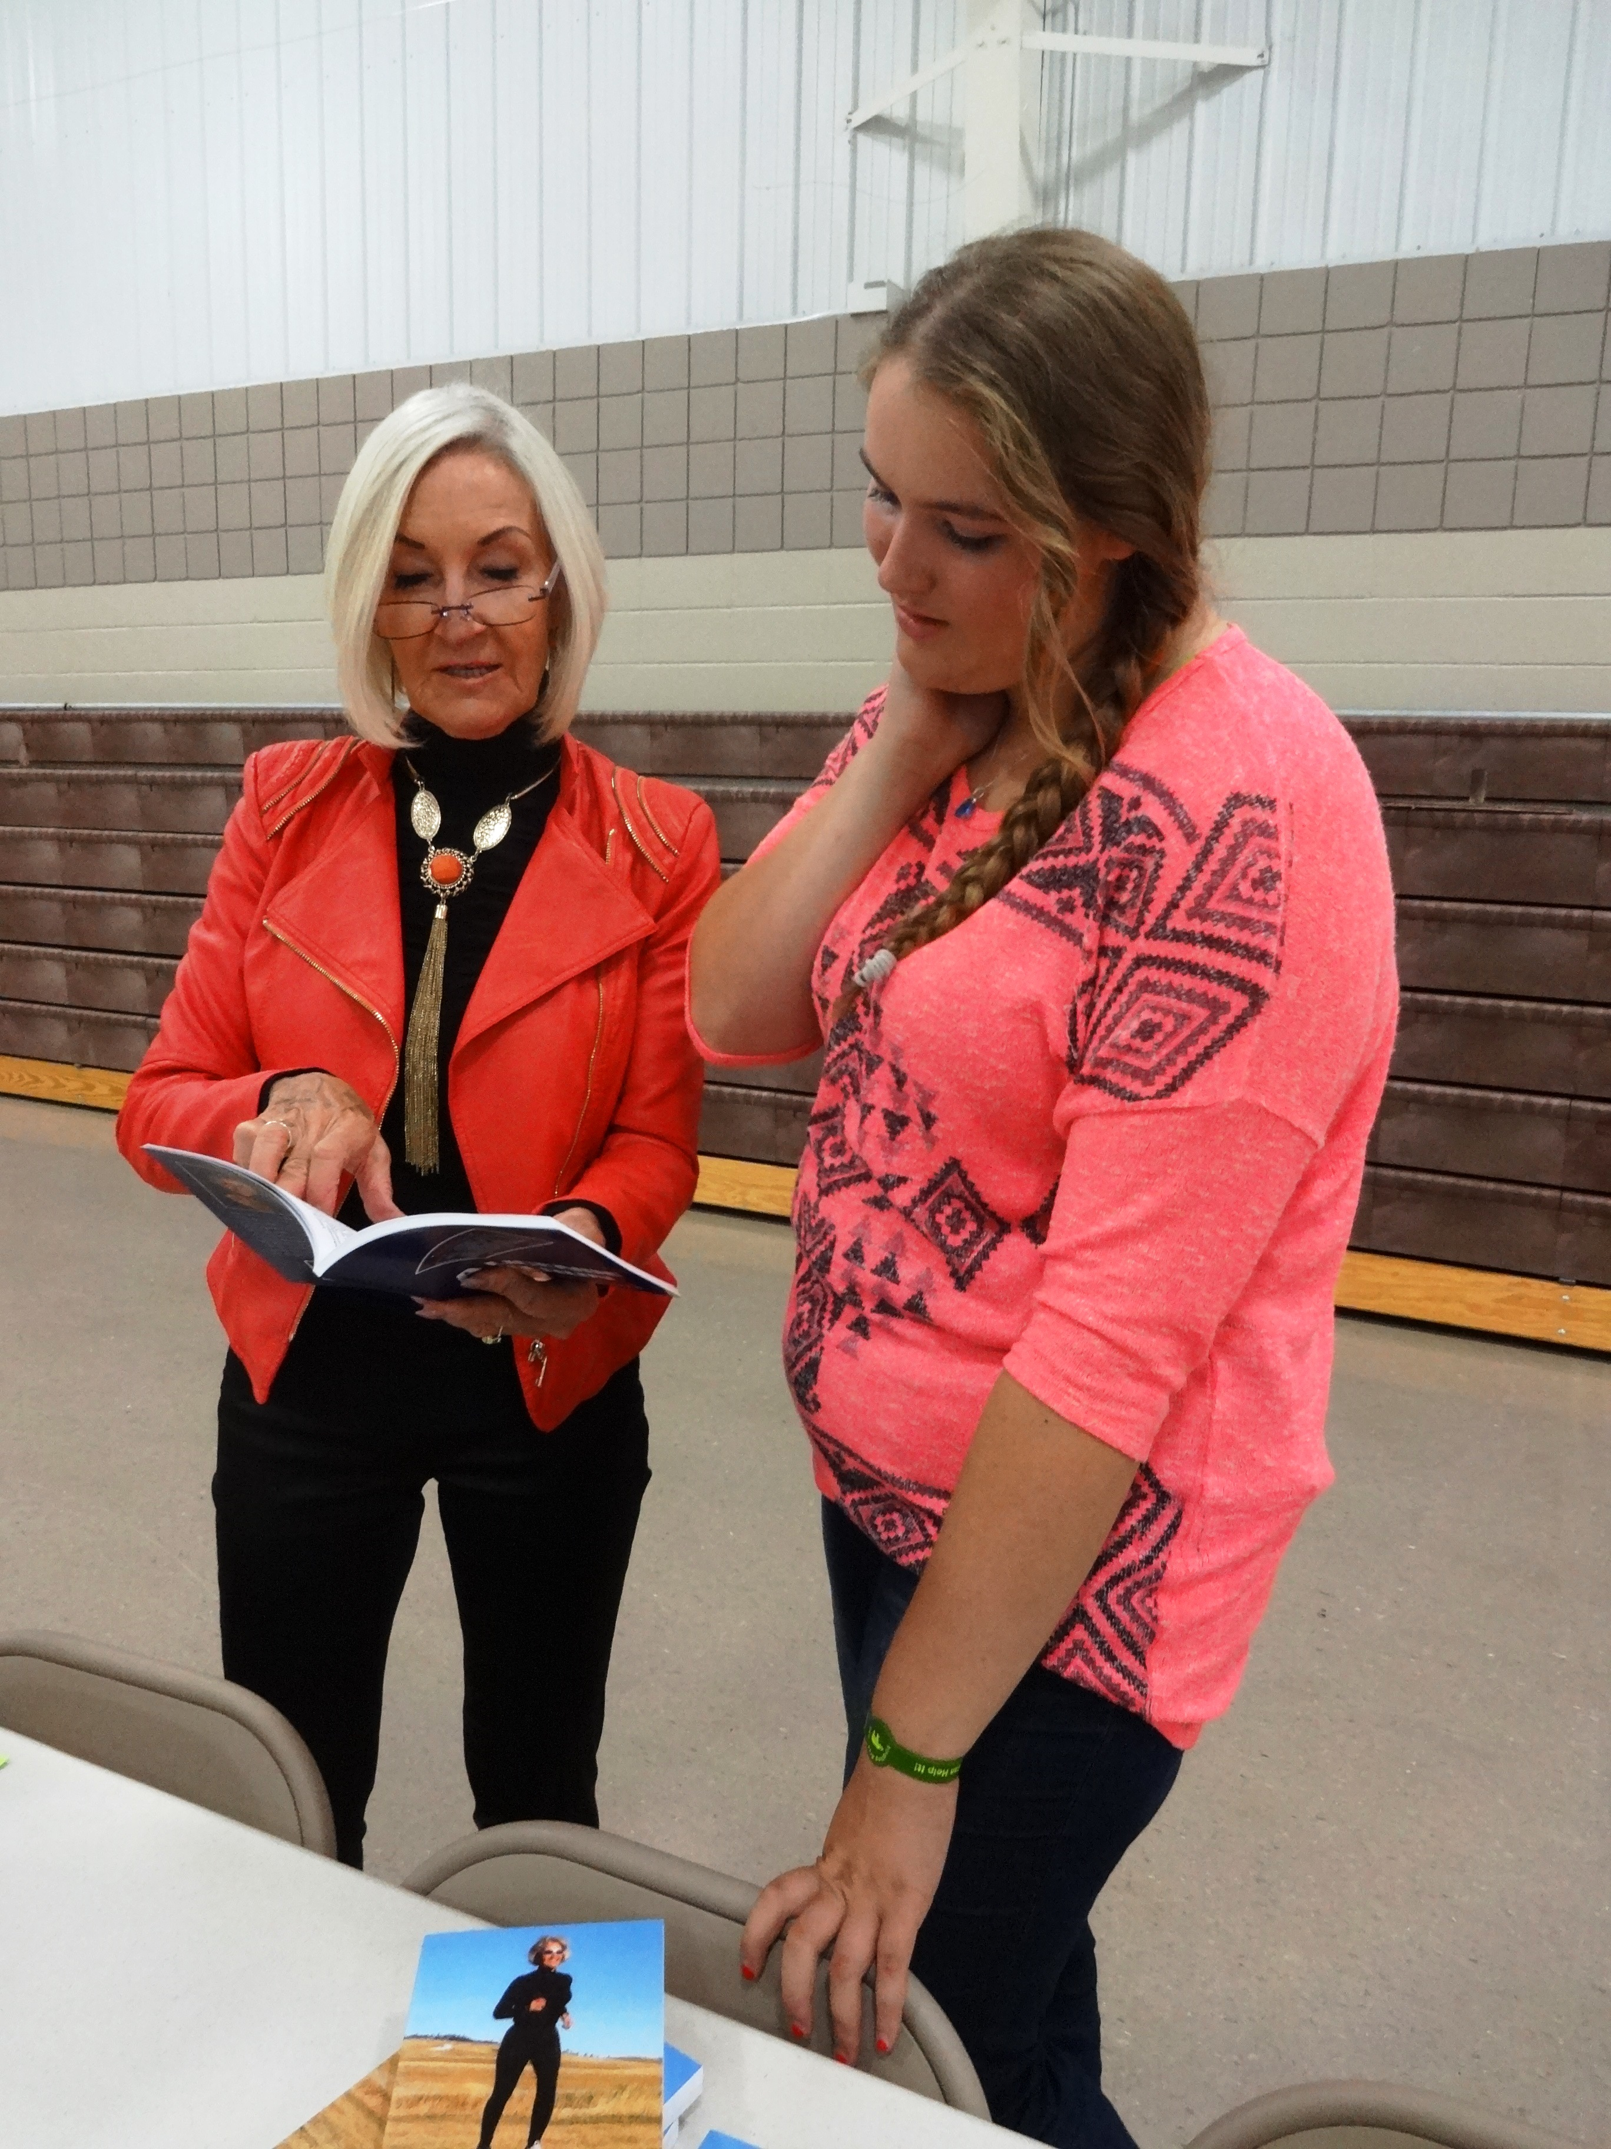
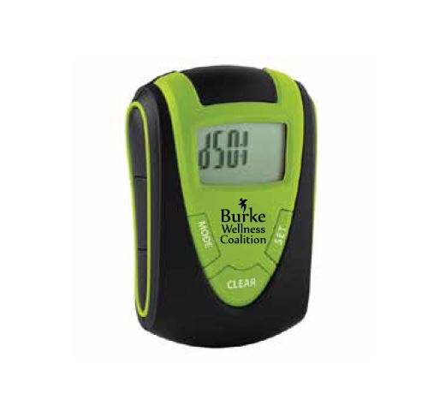
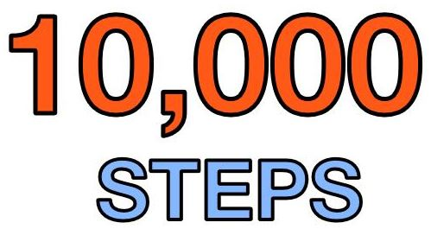
Active Lifestyle Workshop
Burke Civic Center, Burke, SD

Slide 9
Walk Audit Check List & Assessment Tool

Slide 10
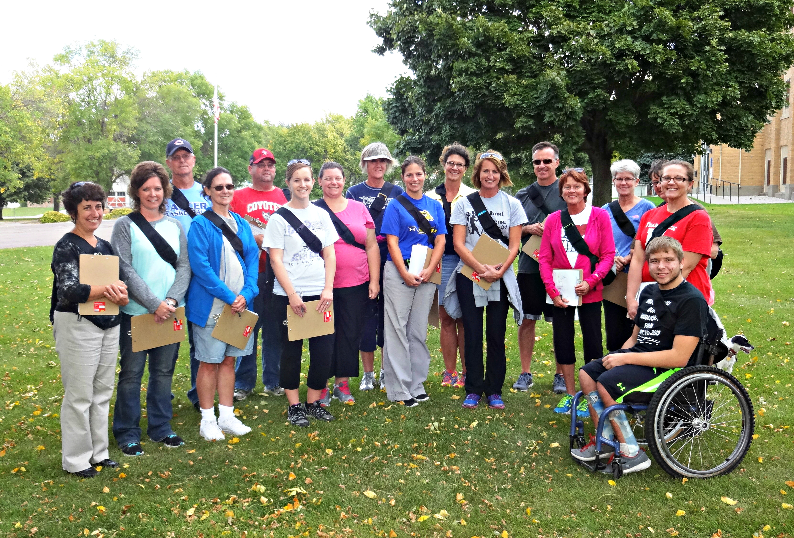
Creating a Walk Audit Team
Burke’s Walk Audit Team – Fall 2014

Slide 11
Creating a Walk Audit Team
Burke’s Walk Audit Team – Fall 2014

Slide 12
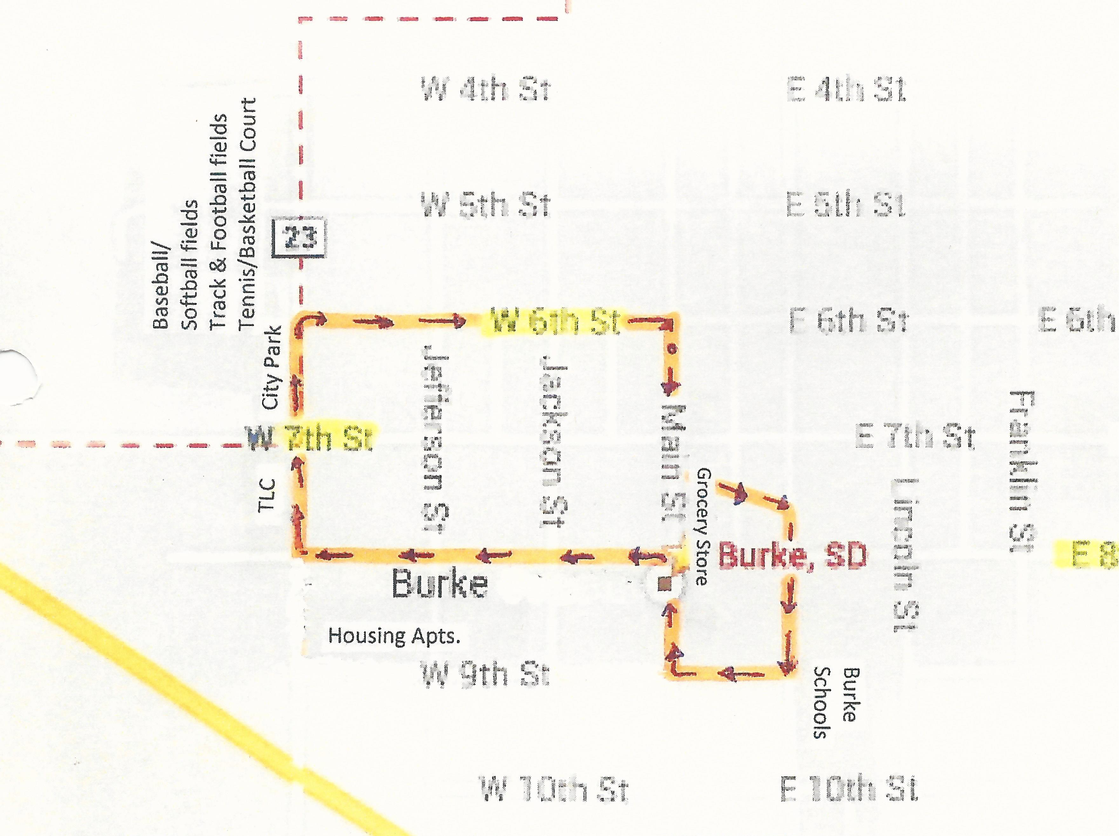
Burke Walk Audit Day
October 1, 2014

Slide 13
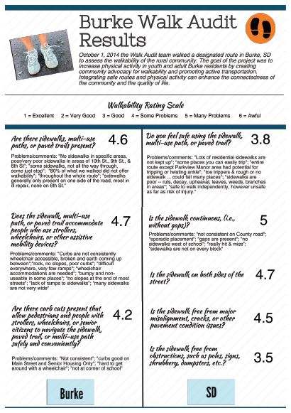
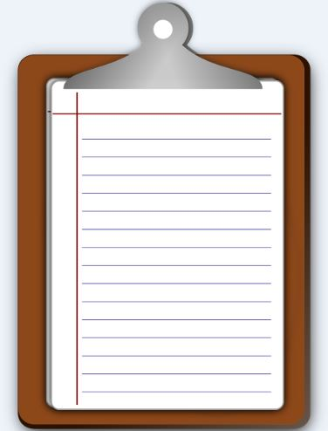
Burke Walk Audit Results – Part 1

Slide 14
Burke Walk Audit Results – Part 2

Slide 15
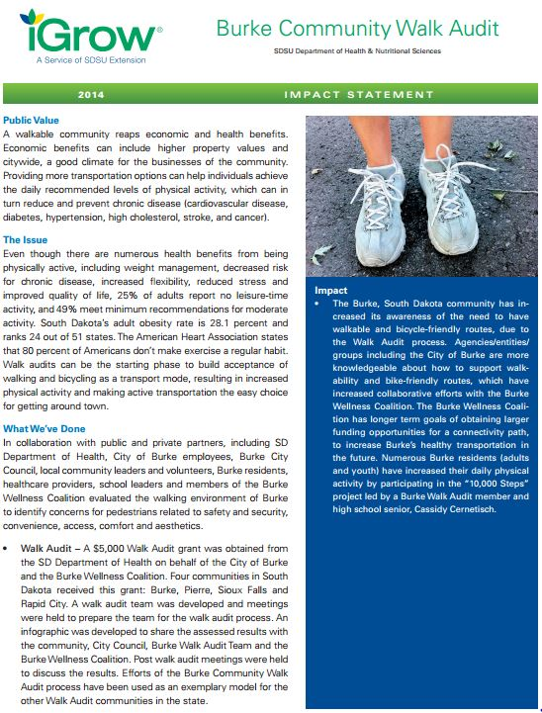
Results shared with the Community
Burke City Council
Burke Wellness Coalition
Local Community Leaders
Burke Residents
Area Health Care Providers

Slide 16
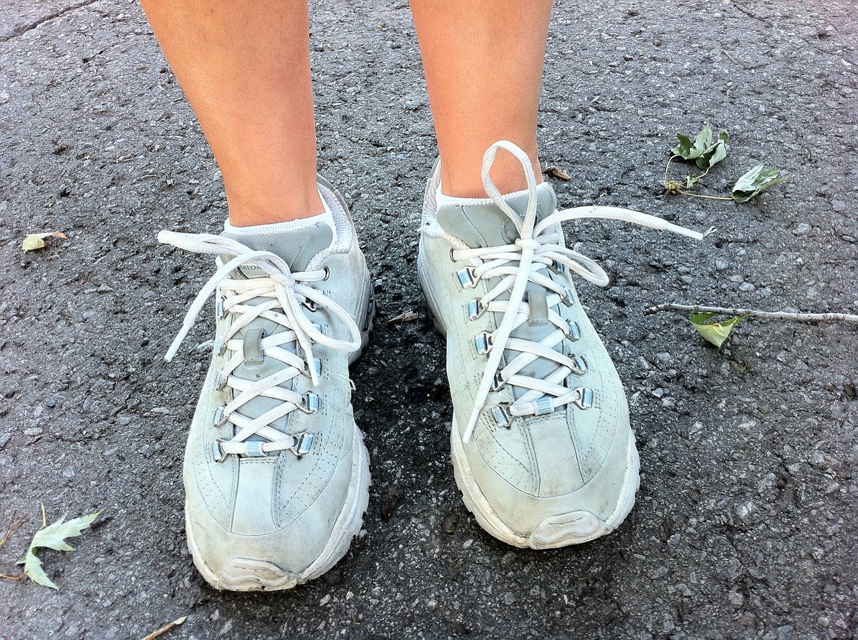
Impacts, Outcomes and Lessons Learned
Increased Awareness
Increased Knowledge
Increased Collaborative Efforts

Slide 17
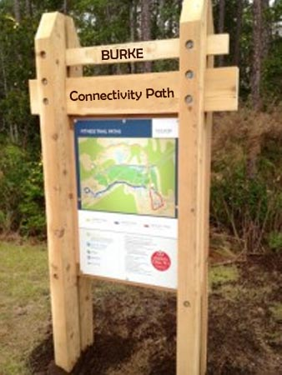
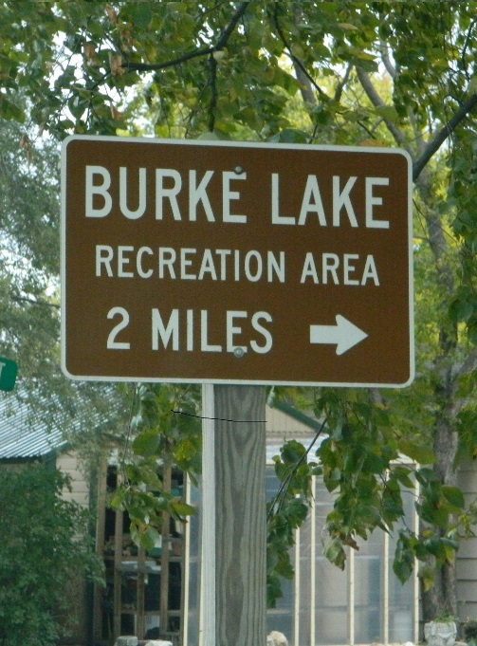
Impacts, Outcomes and Lessons Learned
The Vision:
Burke Wellness Coalition has long-term goals of obtaining funding opportunities for a connectivity path, to increase Burke’s healthy transportation in the future.

Slide 18
Next Steps: Burke Walks!
60+ attended the Free Workshop

Slide 19
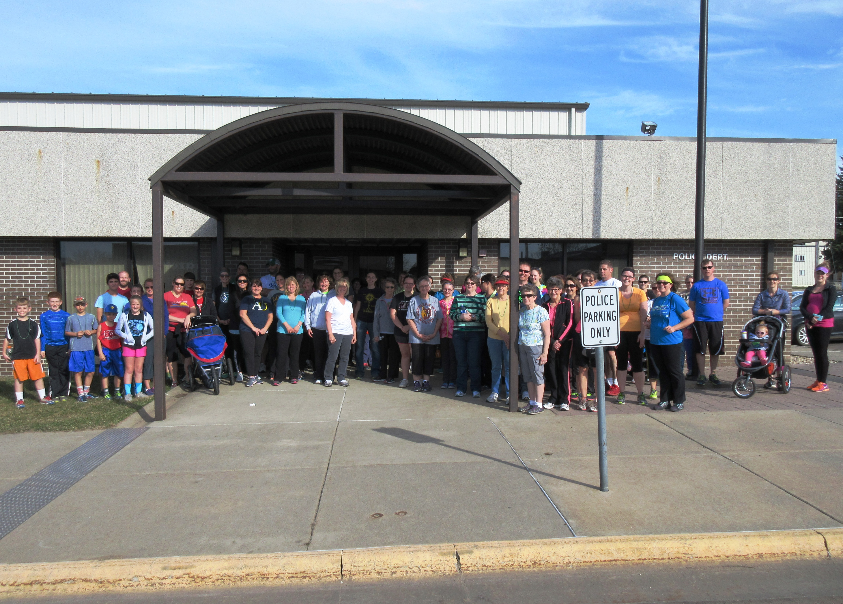
Burke Walks! 1st Walk (3/13) 66 walkers
Bi-monthly, 2-mile Themed Walks

Slide 20
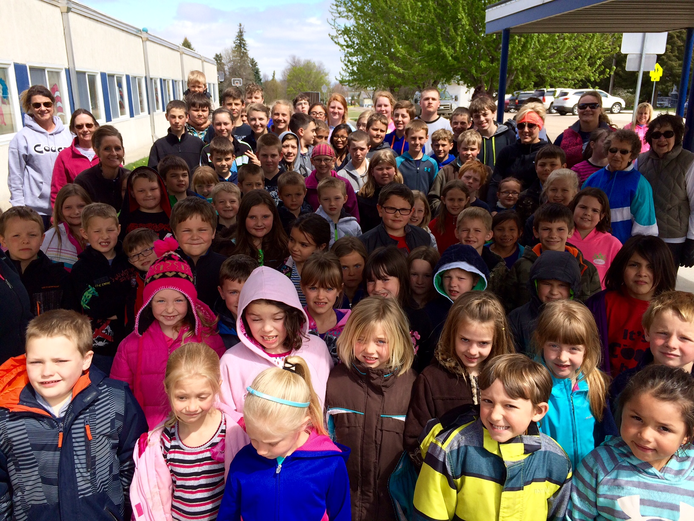
Today’s Walk Audit outcome: There’s a Walking Movement happening in Burke, SD!

