Slide 1
South Dakota Department of Health
Chronic Disease Partners Meeting
July 27, 2016
Colleen Winter, Director
Division of Family & Community Health
South Dakota Department of Health
1

Slide 2
2015-2020
DOH Strategic Plan
Vision
Healthy People
Healthy Communities
Healthy South Dakota
To promote, protect and improve the health of every South Dakotan
Serve with integrity
Eliminate health disparities
Demonstrate leadership and accountability
Focus on prevention and outcomes
Leverage partnerships
Promote innovation
Mission
Guiding
Principles
2

Slide 3
GOAL 1
Improve the quality, accessibility, and effective use of healthcare
Promote the right care at the right time in the right setting
Sustain healthcare services across South Dakota
Provide effective oversight and assistance to assure quality healthcare facilities, professionals, and services
3

Slide 4
GOAL 2
Support life-long health for South Dakotans
Reduce infant mortality and improve the health of infants, children, and adolescents
Increase prevention activities to reduce injuries
Prevent and reduce the burden of chronic disease
4

Slide 5
GOAL 3
Prepare for, respond to, and prevent public health threats
Prevent and control infectious disease
Build and maintain State Public Health Laboratory (SPHL) capacity and ensure a culture of biosafety
Identify the top hazardous environmental conditions in South Dakota that negatively impact human health
Strengthen South Dakota’s response to current and emerging public health threats
Prevent injury and illness through effective education and regulation
5

Slide 6
GOAL 4
Develop and strengthen strategic partnerships to improve public health
Reduce completed and attempted suicides through statewide and local efforts
Reduce the health impact of substance abuse and mental health disorders
Reduce health disparities of at-risk populations through innovative and collaborative efforts
6

Slide 7
GOAL 5
Maximize the effectiveness and strengthen infrastructure of the Department of Health
Increase effective communication
Promote a culture of organizational excellence
Leverage resources to accomplish the Department of Health’s mission
7

Slide 8
Key Performance Measures
The DOH strategic plan has 27 performance indicators that are tracked to determine progress in each goal area
DOH identified 5 key performance indicators that would be benchmarks of success.
Key performance dashboards were selected based on their significance and overarching impact on population health
8

Slide 9
Key Performance Dashboards
Increase the percent of South Dakota adults who have visited a doctor for a routine check-up within the past 2 years from 80.1% in 2014 to 90% by 2020
Reduce the 5-year infant mortality rate from 6.9 per 1,000 births in 2010-2014 to 6.0 by 2020
Reduce the percentage of adults that currently smoke from 18.6% in 2014 to 14.5% by 2020
Increase the percent of children aged 19-35 months who receive recommended vaccinations from 76.3% in 2014 to 80% by 2020
Reduce the suicide age-adjusted death rate for South Dakota from 17.1 per 100,000 in 2014 to 12.6 per 100,000 by 2020
9

Slide 10
Performance Dashboards
Each dashboard provides detailed information on:
Significance of measure
South Dakota and national rates
2020 target
Trend data
Dashboards are posted on the DOH strategic plan website at http://doh.sd.gov/strategicplan/
Dashboards link to a specific goal area within the DOH strategic plan where there are links for additional program information
10

Slide 11
Chronic Disease Data
Reduce the percentage of school-age children and adolescents who are obese from 16.0% in 2014-2015 to 14% by 2020 (SD School Height and Weight Data Report)
Reduce the percentage of adults who currently smoke from 18.6% in 2014 to 14.5% by 2020 (BRFSS)
Increase the percentage of adults who meet the recommended physical activity aerobic guidelines from 53.7% in 2013 to 59% by 2020 (BRFSS)
Increase the percentage of adults age 50-75 who are up-to-date with recommended colorectal cancer screening from 66.7% in 2014 to 80% by 2020 (BRFSS)
Increase the percent of Native Americans who report good to excellent health status from 77% in 2012-2014to 87% by 2020 (BRFSS)
Reduce the percent of low-income South Dakotans who currently smoke from 32.7% in 2013-2014 to 31.5% by 2020 (BRFSS)

Slide 12
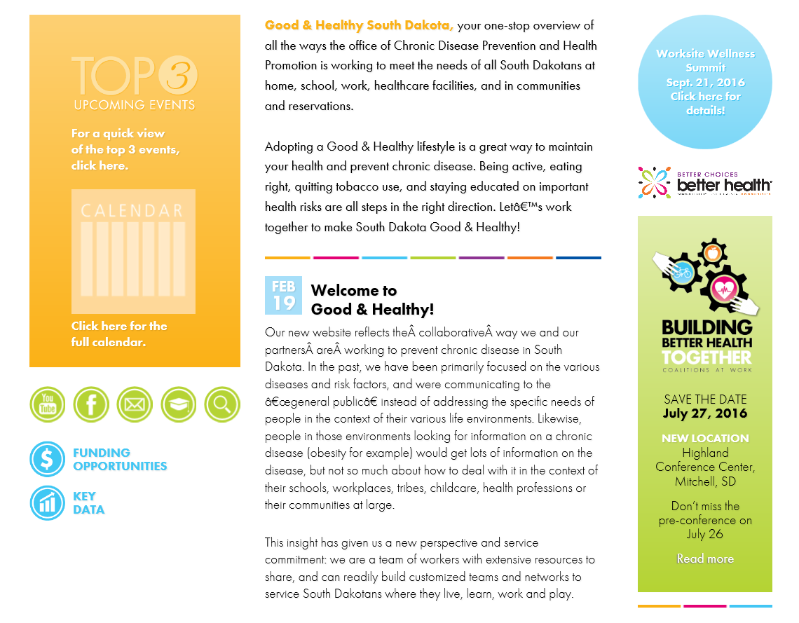
Chronic Disease Data

